Slide 1

jUnit

Slide 2
Objectives
At the end of this session participants will be able to:
Describe Junit
List out the benefits of Junit
Describe Junit Mechanics
Describe Test Method
Describe Assertions
Understand Assertions methods
Write Test cases
Write Test Suites

Slide 3
Agenda
Introduction to Junit
Uses and benefits of Junit
Junit Mechanics
Test Method and Assertions
Writing Test cases & Test Suites

Slide 4
The Problem
“Testing is not closely integrated with development. This prevents you from measuring the progress of development — you can't tell when something starts working or when something stops working.”
Interactive testing is tedious and seldom exhaustive.
Automated tests are better, but,
how to introduce tests interactively?
how to organize suites of tests?

Slide 5
Testing Practices
During Development
When you need to add new functionality, write the tests first.
You will be done when the test runs.
When you need to redesign your software to add new features, refactor in small steps, and run the (regression) tests after each step.
Fix what’s broken before proceeding.
During Debugging
When someone discovers a defect in your code, first write a test that demonstrates the defect.
Then debug until the test succeeds.
“Whenever you are tempted to type something into a print statement or a debugger expression, write it as a test instead.”
- Martin Fowler

Slide 6


JUnit - A Testing Framework
JUnit is a simple framework to write repeatable tests. It is an instance of the xUnit architecture for unit testing frameworks written by Kent Beck and Erich Gamma
For documentation of how to use JUnit http://junit.sourceforge.net/doc/cookbook/cookbook.htm

Slide 7
JUnit 3.8
JUnit is a simple “testing framework” that provides:
classes for writing Test Cases and Test Suites
methods for setting up and cleaning up test data (“fixtures”)
methods for making assertions
textual and graphical tools for running tests
JUnit distinguishes between failures and errors:
A failure is a failed assertion, i.e., an anticipated problem that you test.
An error is a condition you didn’t check for, i.e., a runtime error.

Slide 8
Junit Mechanics
Assert
<interface>
Test
TestCase
TestSuite
Your TestClass
8
Copyright © 2016 Tech Mahindra. All Rights Reserved.

Slide 9
Junit Mechanics
Create java class
Define test case class using below process
Define a subclass of TestCase.
Override the setUp() & tearDown() methods.
Define one or more public testXXX() methods
Exercise the object(s) under test.
Asserts the expected results.
Copyright © 2016 Tech Mahindra. All Rights Reserved.

Slide 10
Junit Mechanics
setUp()
This method is called before a test is executed.
There are often some repeated tasks that must be done prior to each test case.
Examples: create some “interesting” objects to work with, open a network connection, etc.
tearDown()
This method is called after a test is executed.
There may be repeated tasks to clean up after test execution.
Ensures resources are released, test system is in known state for next test case, etc.
Copyright © 2016 Tech Mahindra. All Rights Reserved.

Slide 11
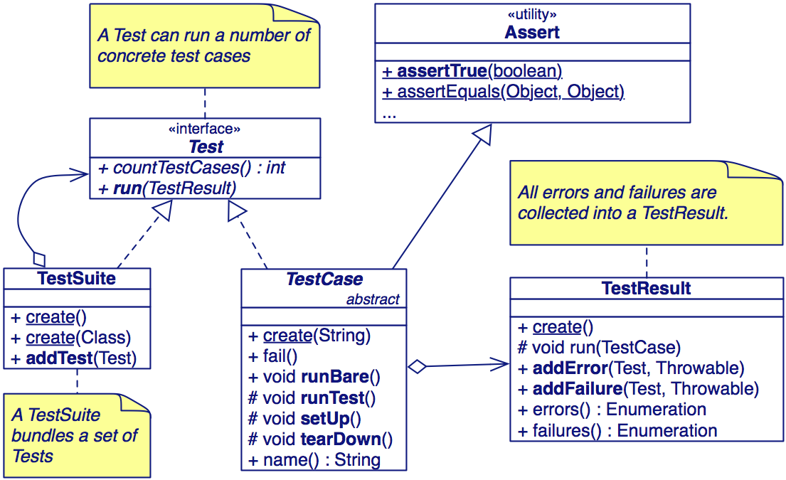
The JUnit 3.x Framework

Slide 12
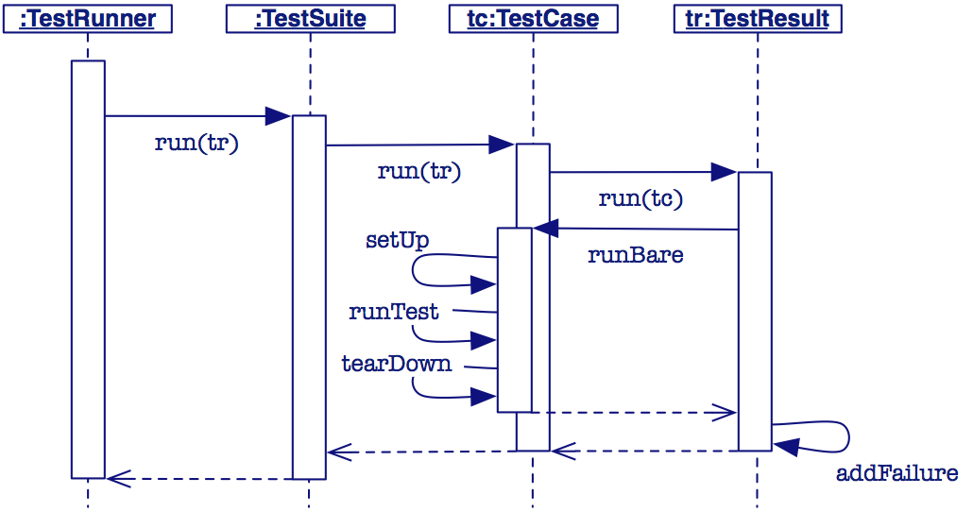
A Testing Scenario
The framework calls the test methods that you define for your test cases.

Slide 13
Assertion
Assertions are defined in the JUnit class Assert
If an assertion is true, the method continues executing.
If any assertion is false, the method stops executing at that point, and the result for the test case will be fail.
If any other exception is thrown during the method, the result for the test case will be error.
If no assertions were violated for the entire method, the test case will pass.
All assertion methods are static methods
Copyright © 2016 Tech Mahindra. All Rights Reserved.

Slide 14
Assertion methods (1)
Boolean conditions are true or false
assertTrue(condition)
assertFalse(condition)
Objects are null or non-null
assertNull(object)
assertNotNull(object)
Objects are identical (i.e. two references to the same object), or not identical.
assertSame(expected, actual)
true if: expected == actual
assertNotSame(expected, actual)
Copyright © 2016 Tech Mahindra. All Rights Reserved.

Slide 15
Assertion methods (2)
“Equality” of objects:
assertEquals(expected, actual)
valid if: expected.equals( actual )
“Equality” of arrays:
assertArrayEquals(expected, actual)
arrays must have same length
for each valid value for i, check as appropriate:
assertEquals(expected[i],actual[i])
or
assertArrayEquals(expected[i],actual[i])
There is also an unconditional failure assertion fail() that always results in a fail verdict.
Copyright © 2016 Tech Mahindra. All Rights Reserved.

Slide 16
Write Test Case(Java Class)
public class Calculator
{
public int add(int a,int b) {
return a+b;
}
public int divid(int a,int b) {
return a/b;
}
public int sub(int a,int b) {
return a+b;
}
}
Copyright © 2016 Tech Mahindra. All Rights Reserved.

Slide 17
Write Test Case
import junit.framework.TestCase;
public class TestCalculator1 extends TestCase
{
Calculator c=null;
public TestCalculator1(String name)
{
super(name);
}
protected void setUp() throws Exception
{
c=new Calculator();
super.setUp();
}
Copyright © 2016 Tech Mahindra. All Rights Reserved.

Slide 18
Write Test Case
protected void tearDown() throws Exception {
System.out.println("tearDown");
super.tearDown();
c=null;
}
public void testAdd() {
System.out.println("Add");
assertEquals(8, c.add(5, 3));
}
}
Copyright © 2016 Tech Mahindra. All Rights Reserved.

Slide 19
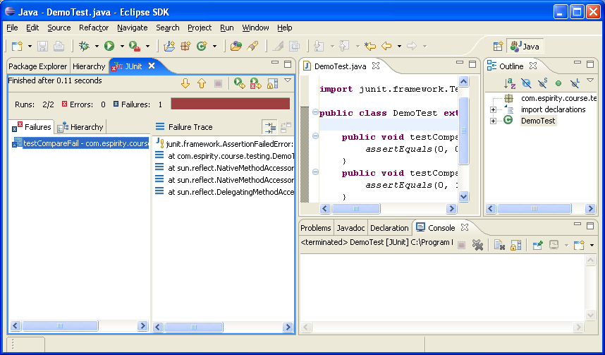
Running TestCase
Select TestCase class
From the Run menu select Run → Run As → JUnit Test
This will run the tests in your TestCase class along with the setup and teardown methods
You will then get a report in the JUnit Window

Slide 20
JUnit Window…
Red indicates a test has failed
If you wish to see the tests in TestCase click on the Hierarchy tab
You can see which test failed
You can see the call trace leading to the failure
Notes:
JUnit window gives you a report on running the tests. It indicates which tests fail and also gives you the call trace for each failure. All the details on running the tests are displayed in the window. These details include how many errors occurred, how many tests run.

Slide 21
…JUnit Window
You can see how many tests ran
Errors occur when exceptions are thrown
How many failures occurred
You can see the details of the failure

Slide 22
Test Suite
With Junit’s API, tests can be grouped into a suite by using the TestSuite class.
JUnit TestSuite is a container class of junit.framework.TestSuite, used in Junit that allows you to group multiple test cases into a collection and run them together.
Copyright © 2016 Tech Mahindra. All Rights Reserved.

Slide 23
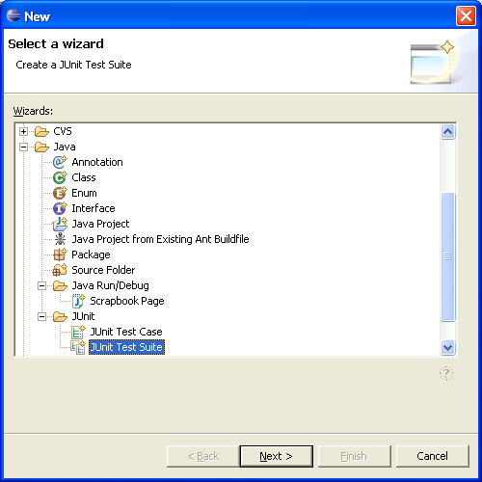
Creating JUnit TestSuite…
To create a TestSuite
Select your testing package
From the context menu
select New → Other… → Java → Junit
Then from the Wizard select JUnit Test Suite
Notes:
TestSuite is a class from JUnit framework that allows you to group and run individual tests together. Creation of a test suite in Eclipse is similar to creation of test case, as wizards get you through the process of creating it.

Slide 24
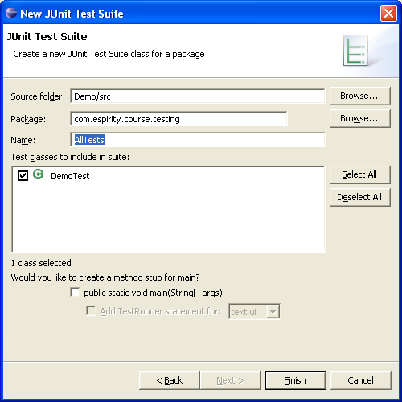
…Creating JUnit TestSuite
Fill in the name of your TestSuite Class
Select the TestCases to include in your TestSuite

Slide 25
Write TestSuite
import junit.framework.Test;
public class AllInclusiveTestSuite extends TestSuite{
public static TestSuite suite() {
TestSuite suite = new TestSuite);
suite.addTestSuite(FirstTestCase.class));
suite.addTestSuite(SecondTestCase.class));
return suite;
}
}
Copyright © 2016 Tech Mahindra. All Rights Reserved.

Slide 26
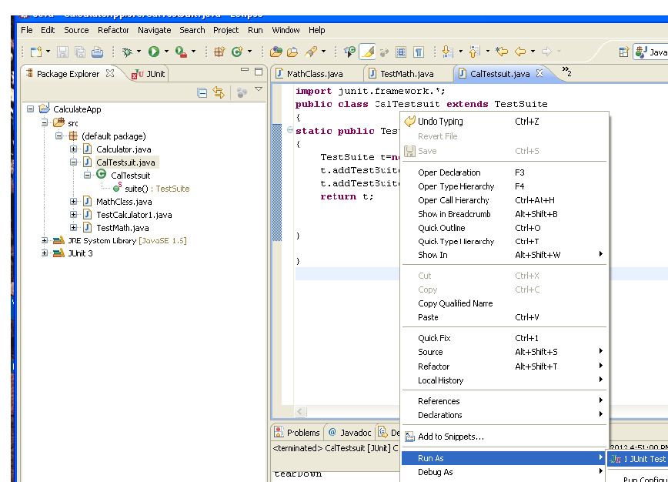
Running TestSuite
Select TestSuite class
From the Run menu select Run → Run As → JUnit Test
This will run the test cases in your TestSuite class
You will then get a report in the JUnit Window
Notes:
Running test suites is similar to running test cases. The difference is that with running the test case you run an individual test case class, and with running the test suite you run multiple test cases, i.e. multiple classes.

Slide 27
Using Annotation (@)

Slide 28
Annotation in Junit
@Test
You don’t need to prefix your test cases with “test”.
In addition, your class does not need to extend from “TestCase” class.
Example
@Test public void addition()
{ assertEquals(12, simpleMath.add(7, 5)); }
@Test public void subtraction()
{ assertEquals(9, simpleMath.substract(12, 3)); }
Copyright © 2016 Tech Mahindra. All Rights Reserved.

Slide 29
Annotation in Junit
@Before and @After
We use @Before and @After annotations for “setup” and “tearDown” methods respectively.
They run before and after every test case.
Setup and teardown methods no longer have to be named as setup() and tearDown().
Example
@Before public void runBeforeEveryTest() { simpleMath = new SimpleMath(); }
@After public void runAfterEveryTest() { simpleMath = null; }
Copyright © 2016 Tech Mahindra. All Rights Reserved.

Slide 30
Annotation in Junit
@BeforeClass and @AfterClass
We use @BeforeClass and @AfterClass annotations for class wide “setup” and “tearDown” respectively.
They run for one time before and after all test cases
Methods with these annotations must be static
Example
@BeforeClass public static void runBeforeClass()
{ // run for one time before all test cases }
@AfterClass public static void runAfterClass()
{ // run for one time after all test cases }
Copyright © 2016 Tech Mahindra. All Rights Reserved.

Slide 31
Annotation in Junit
Exception Handling
Use “expected” paramater with @Test annotation for test cases that expect exception.
Write the class name of the exception that will be thrown..
Example
@Test(expected = ArithmeticException.class) public void divisionWithException()
{ // divide by zero simpleMath.divide(1, 0); }
Timeout
The test fails when the timeout period exceeds.
@Test(timeout = 1000)
Copyright © 2016 Tech Mahindra. All Rights Reserved.

Slide 32
Summary
Introduction to Junit
Benefits of Junit
Junit Mechanics
Test Method and Assertions
Writing Test cases & Test Suites

Slide 33
Log4J

Slide 34
Objective
At the end of the training, you will be able to
Understand the architecture and components of Log4j
Configure Log4j framework.

Slide 35
Introduction
Using the Log4J as a standard approach to logging.
Logging defined as “A record, as of the performance of a machine or the progress of an undertaking.”(Dictionary.com)

Slide 36
The Value of logging
Do programmers use debuggers or Loggers?
Logging is often faster then using a debugger.
Logging can be used to diagnose problems in the field.
Debugging is difficult in a distributed computing environment.
Note: The key to using a logger for debugging is to have lots of events recorded.

Slide 37
Logging activities
Note how similar this activities are.
Tracing
Debugging
Error Handling
Logging
(All write output to a storage device. Only the type of information written is different)

Slide 38
What is logged?
Types of information logged
Program flow
Detailed information about what occurs in a method at a granular level.
Information about a specific error that has occurred in the system.
Document historical business events that have occurred.

Slide 39
Architecture
The Log4j package is distributed under the Apache Software License
The latest Log4j version can be found at http://logging.apache.org/log4j/
Log4j has been ported to the C, C++, C#, Perl, Python, Ruby, and Eiffel languages

Slide 40
Why Log4j?
Log4j is designed to be fast and extensible
Log4j is simple and easy to use
Able to disable certain log statements while allowing others to print unhindered

Slide 41
Components of Log4j
Log4j has three main components:
Logger: Handling the majority of log operations
Appender: Controlling the output of log operations
Layout: Formatting the output for Appender

Slide 42
Component --- Logger
Logger has 7 levels
ALL
DEBUG
INFO
WARN
ERROR
FATAL
OFF

Slide 43
Example
import org.apache.log4j.*;
public class Demo {
static Logger log = Logger.getLogger(Demo.class.getName());
public static void main(String[] args) {
BasicConfigurator.configure();
log.info("Starting up...");
log.setLevel(Level.WARN);
log.info("This message should not appear!");
try {
// Divide by zero.
int x = 5;
int y = 20 / (5 - x);
} catch (Exception e) {
log.error("Oops!", e);
}
}
}

Slide 44
Summary
Introduction to Log4j
Architecture and Components of Log4j Framework
Configuration of Log4j

Slide 45

Thank You

